Slide 1
William Stallings
Computer Organization and Architecture
7th Edition
Chapter 7
Input/Output

Slide 2
Input/Output Problems
I/O contains some “intelligence”.
Wide variety of peripherals
  Delivering different amounts of data
  At different speeds
  In different formats
All slower than CPU and RAM
Need I/O modules

Slide 3
Input/Output Module
Interface to CPU and Memory
Interface to one or more peripherals

Slide 4
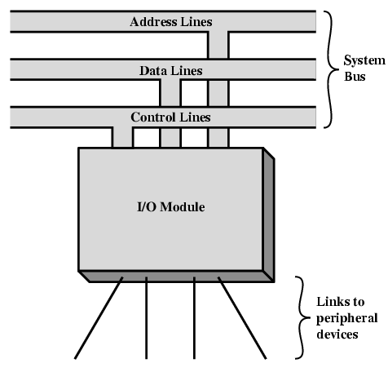
Generic Model of I/O Module

Slide 5
External Devices
Human readable
  Screen, printer, keyboard
Machine readable
  Monitoring and control
  Magnetic disk and tape, sensors and actuators used in robotics application.
Communication
  Modem,Network Interface Card (NIC)

Slide 6
I/O Module Functions
Control and timing
Processor communication
Device communication
Data buffering
Error detection

Slide 7
1.I/O Steps(control of the transfer of data from an external device to the processor)
CPU checks I/O module device status
I/O module returns status
If ready, CPU requests data transfer
I/O module gets data from device
I/O module transfers data to CPU
Variations for output, DMA, etc.

Slide 8
2. processor communication
Command decoding
Data
Status reporting
Address recognition

Slide 9
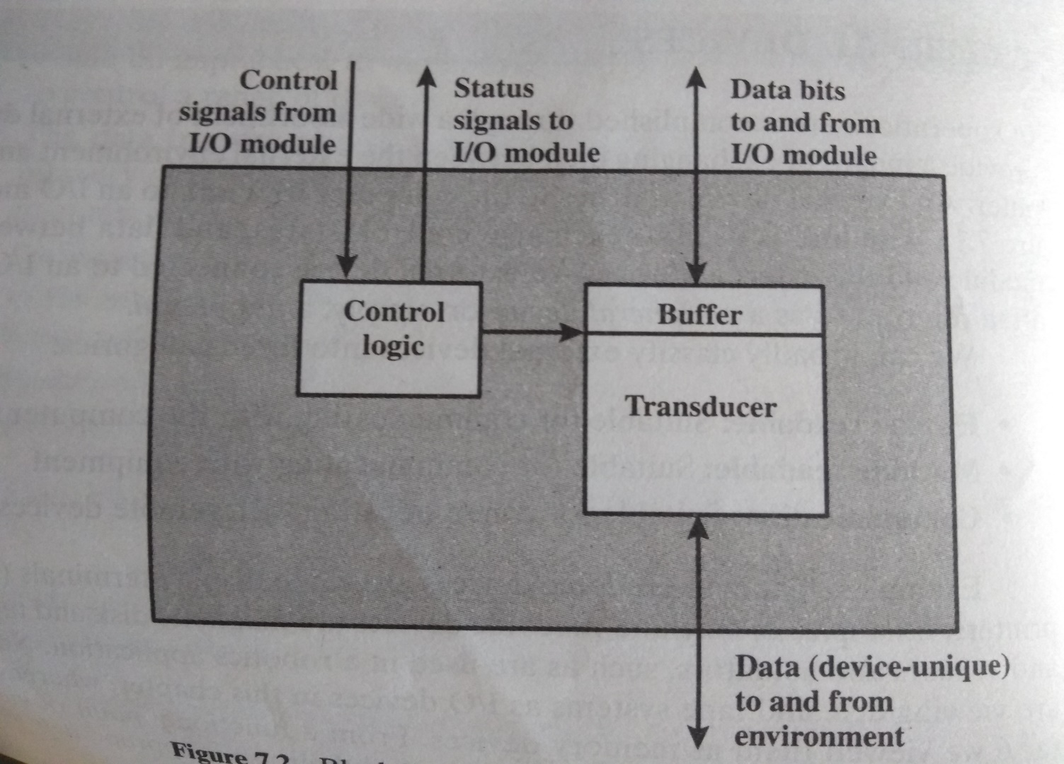
3. Device communication
Commands
Status information
data

Slide 10
4. Data buffering
Transfer rate of processor and memory is high whereas I/O device is low.
Data are buffered in I/O module and then sent to the peripheral device at its data rate and vice versa.

Slide 11
5. Error detection
Reporting errors to the processor.
Mechanical and electrical(paper jam,bad disk track)
Transmission errors.(use parity bit)

Slide 12
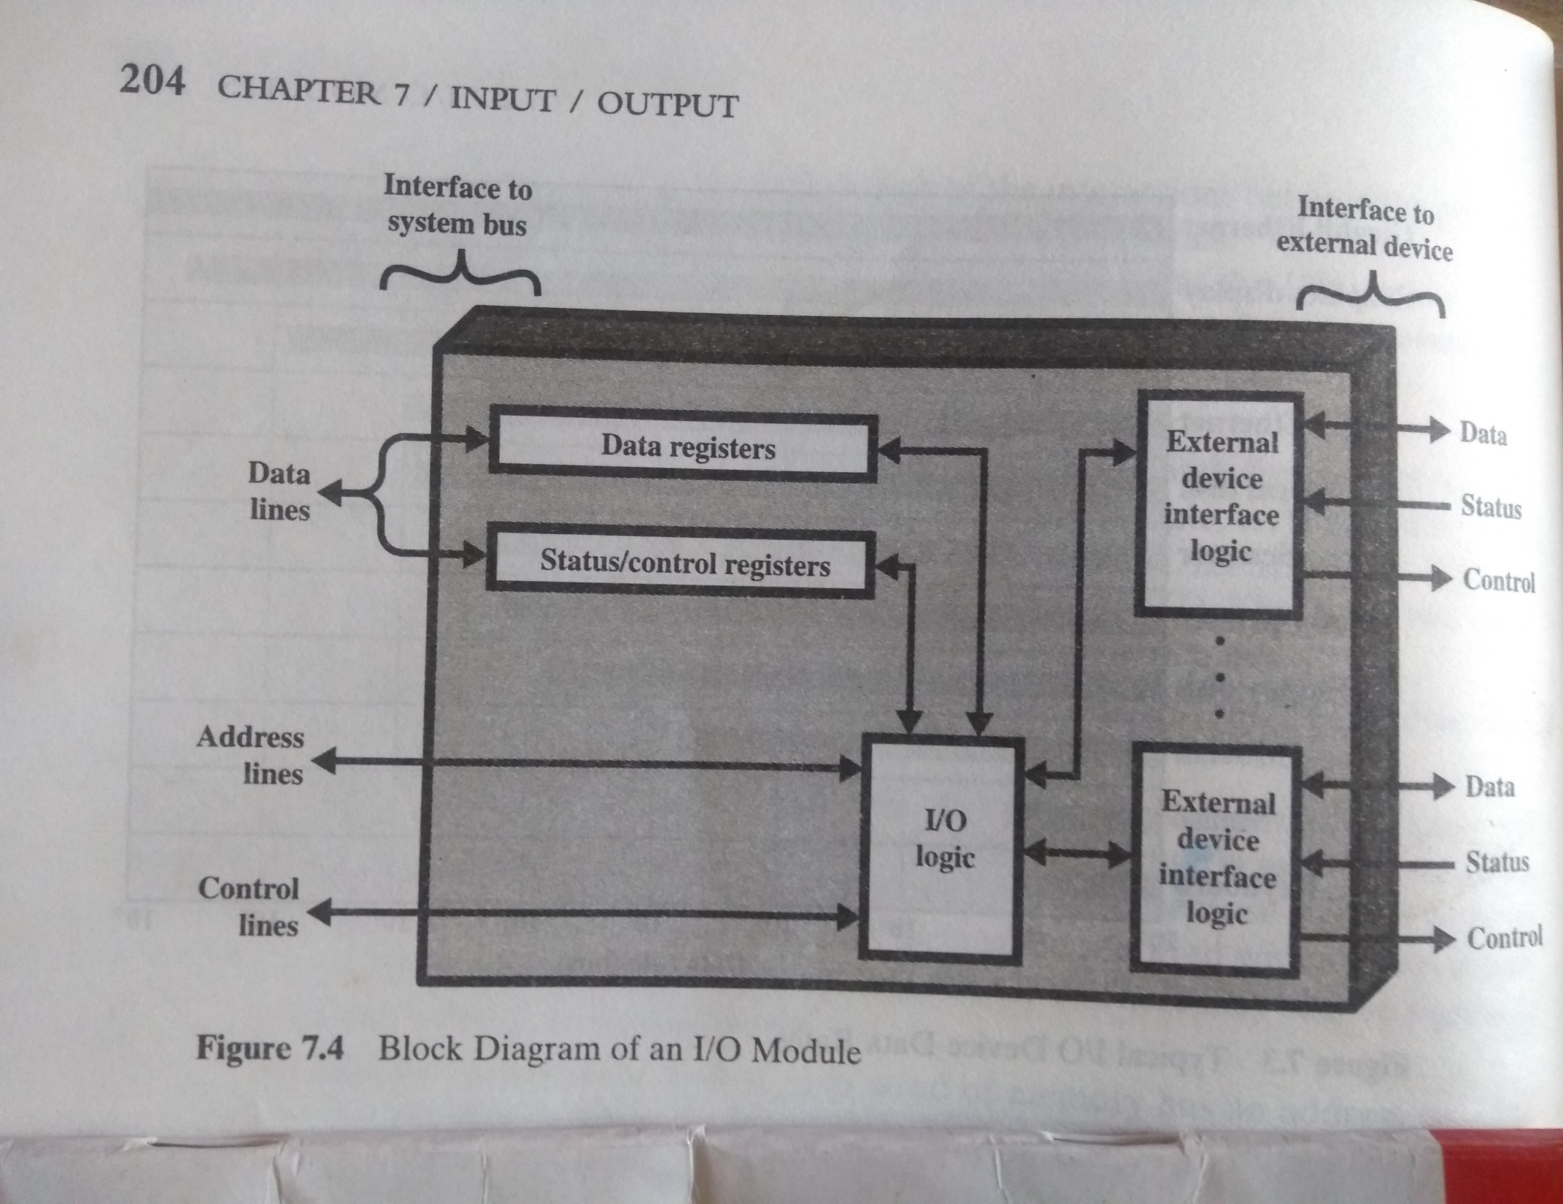
Block diagram of I/O module

Slide 13
Input Output Techniques
Programmed
Interrupt driven
Direct Memory Access (DMA)

Slide 14
PROGRAMMED I/O
Data transfer operations are completely controlled by CPU i.e. CPU executes a program that initiates, directs and terminates the I/O operation

Slide 15
PROGRAMMED I/O: commands
Control: Used to activate a peripheral and tell it
what to do.
Test: test various status conditions
Read: I/O module obtain item of data from peripheral and place it in an internal buffer.
Write: I/O take an item of data(byte or word) from the data bus and transmit that data item to the peripheral.

Slide 16
PROGRAMMED I/O
Useful where h/w costs need to be minimized.
Entire I/O is handled by CPU
STEPS
  1. Read I/O devices status bit
  2. Test status bit to determine if device is ready
  3. If device not ready return to step 1
  4. During interval when device is not ready CPU simply wastes its time until device is ready

Slide 17
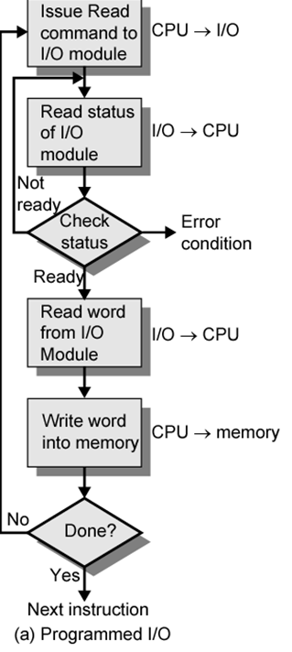

Slide 18
Programmed I/O
CPU has direct control over I/O
  Sensing status
  Read/write commands
  Transferring data
CPU waits for I/O module to complete operation
Wastes CPU time

Slide 19
Programmed I/O - detail
CPU requests I/O operation
I/O module performs operation
I/O module sets status bits
CPU checks status bits periodically
I/O module does not inform CPU directly
I/O module does not interrupt CPU
CPU may wait or come back later

Slide 20
INTERRUPT DRIVEN I/O
Major drawback of programmed I/O is busy waiting
Speed of I/O devices is much slower than CPU
Performance of CPU goes down as it has to repeatedly check for device status
Solution: Switch to another task if device is not ready and thus use interrupt mechanism

Slide 21
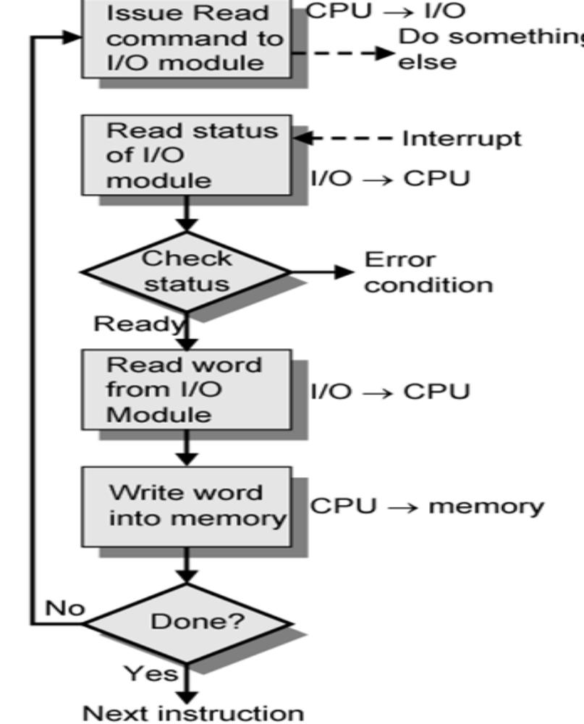

Slide 22
Interrupt Driven I/O
Overcomes CPU waiting
No repeated CPU checking of device
I/O module interrupts when ready

Slide 23
Interrupt Driven I/O
Basic Operation
CPU issues read command
I/O module gets data from peripheral while CPU does other work
I/O module interrupts CPU
CPU requests data
I/O module transfers data

Slide 24
CPU Viewpoint
Issue read command
Do other work
Check for interrupt at end of each instruction cycle
If interrupted:-
  Save context (registers)
  Process interrupt
    Fetch data & store

Slide 25
From I/O module Viewpoint
I/O module receives a READ command from the processor.
Read data from associated peripheral.
Once data is in the module’s data register, the module signals an interrupt over control lines.

Slide 26
Design issues:
Multiple I/O devices: How does the processor determine which device issued the interrupt?
-Use multiple interrupt lines: independent request,software poll, daisy chain
If multiple interrupts have occurred, how does the processor decide which one to process?
-assign priorities to interrupts.

Slide 27
INTERRUPT DRIVEN I/O
An interrupt causes CPU to temporarily transfer control from its current program to another program(an interrupt handler).
Types of interrupts:
Program interrupts(e.g. divide by zero)
Timer interrupts(within the processor)
I/O interrupts(generated for initiation/completion of I/O)
Hardware failure interrupts(power failure,memory parity error)

Slide 28
INTERRUPT DRIVEN I/O
Pentium interrupt structure
Hardware interrupts:
NMI(Non Maskable interrupts : cannot be disabled)
INTR(Interrupt Request: can be disabled)
2.Software interrupts(exceptions):
- generated by an executing program

Slide 29
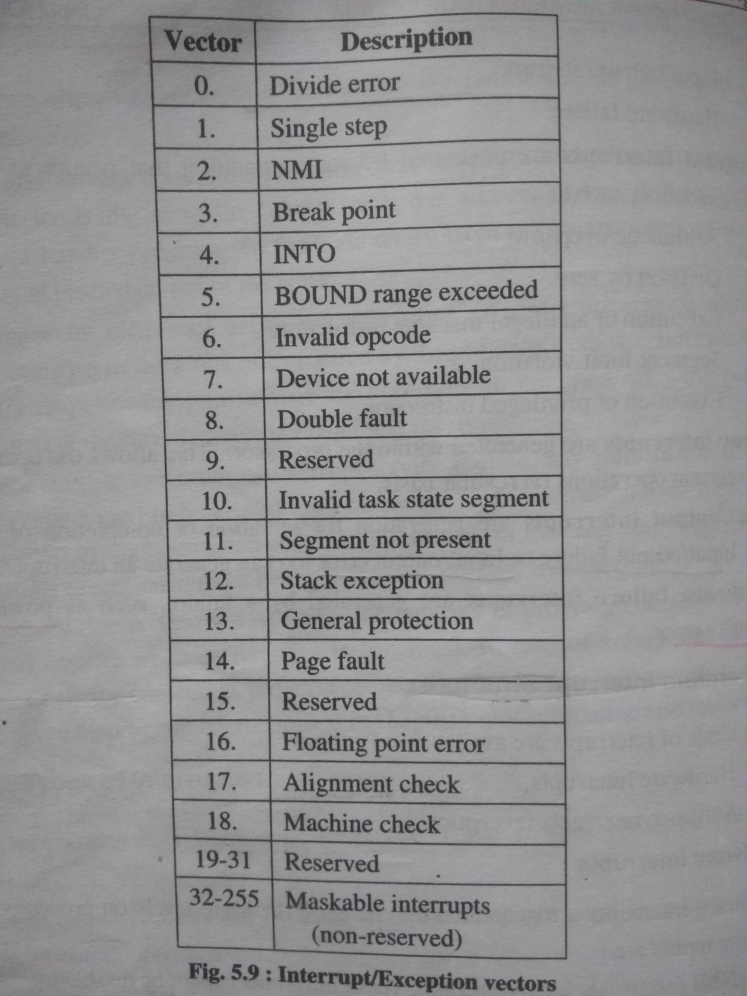
INTERRUPT DRIVEN I/O

Slide 30
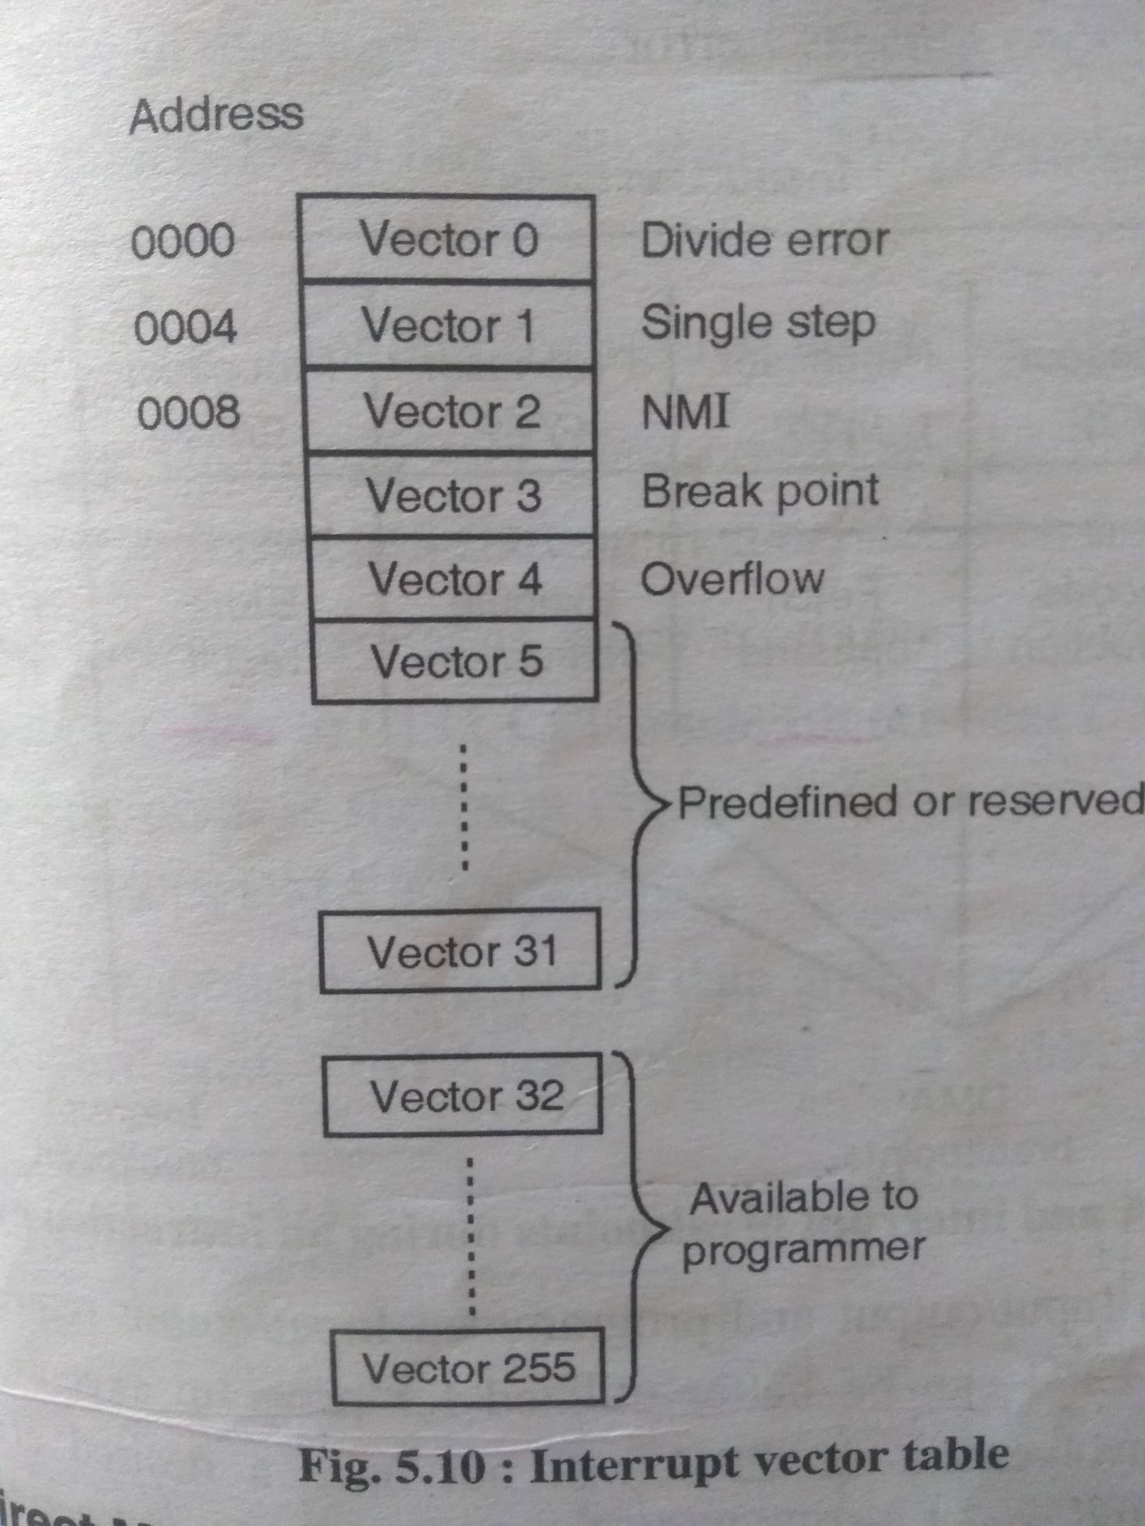
INTERRUPT DRIVEN I/O

Slide 31
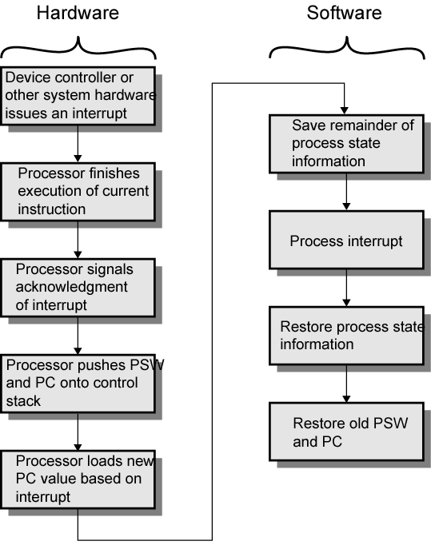
Simple Interrupt
Processing

Slide 32
Multiple Interrupts
Each interrupt line has a priority
Higher priority lines can interrupt lower priority lines
If bus mastering only current master can interrupt

Slide 33
Direct Memory Access
Interrupt driven and programmed I/O require active CPU intervention
  Transfer rate is limited
  CPU is tied up
DMA is the answer
Direct memory access (DMA) is a feature of computer systems that allows certain hardware subsystems to access main system memory (RAM) independently of the central processing unit (CPU).

Slide 34
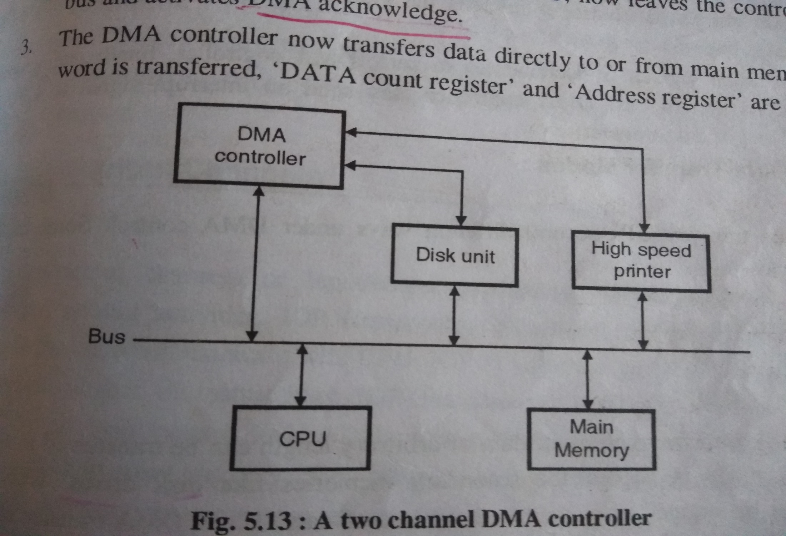
Direct Memory Access

Slide 35
Direct Memory Access
When an input/output is requested, the CPU instructs the DMA module about the operation
Which operation(read/write) to be performed
The address of I/O device to be used
Starting location in memory where the info will be read or written.
No of words to be read/written.
Processor delegates I/O operation to the DMA module and continues with other work.

Slide 36
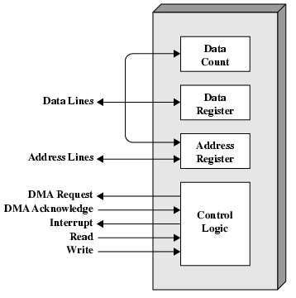
Typical DMA Module Diagram

Slide 37
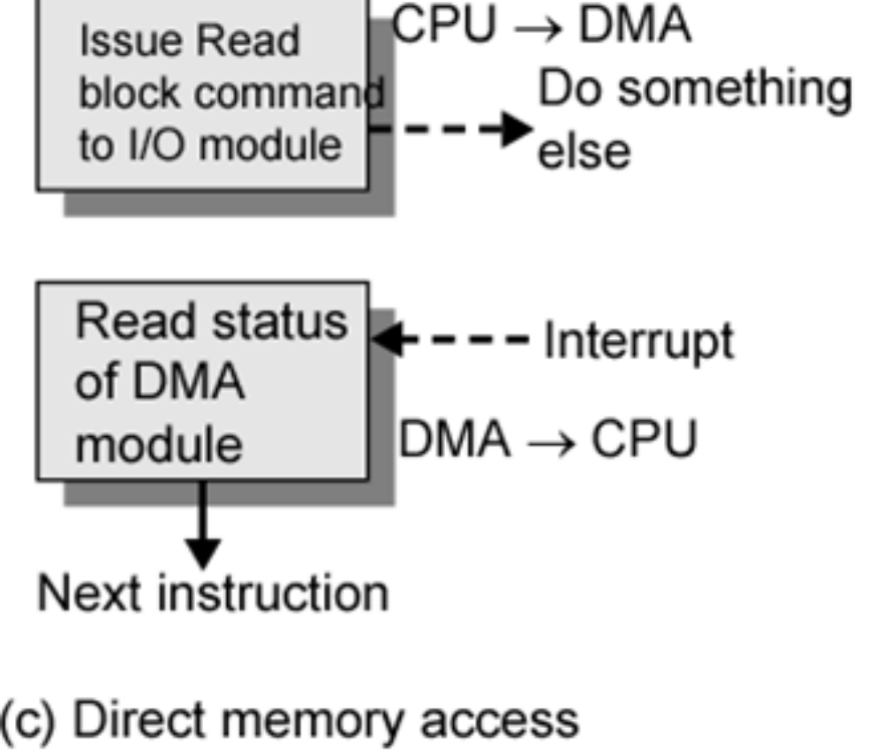
DMA Function
Additional Module (hardware) on bus
DMA controller takes over from CPU for I/O

Slide 38
DMA Operation
CPU tells DMA controller:-
  Read/Write
  Device address
  Starting address of memory block for data
  Amount of data to be transferred
CPU carries on with other work
DMA controller deals with transfer
DMA controller sends interrupt when finished

Slide 39
DMA Operation
Transferring a block data from memory to the Printer
OS writes foll info to DMA registers
memory address
Word count
Read or write operation
2.DMA controller checks whether printer is ready
3.If data count has not reached zero but printer is not ready ,the DMA controller releases system bus
4.If data count register is decremented to zero, DMA controller releases the control of system bus. and sends an interrupt signal to CPU.

Slide 40
DMA Operation
DMA data transfer modes:
DMA block transfer
A block of data of arbitrary length is transferred in a single burst.
Cycle stealing mode
DMA controller is allowed to use system bus to transfer one word of data at a time, after which it must return control of the bus to the CPU.
CPU and DMA use the system bus alternatively.
After each cycle(fetch instruction ,decode instruction, fetch operand, execute instruction, store result)

Slide 41
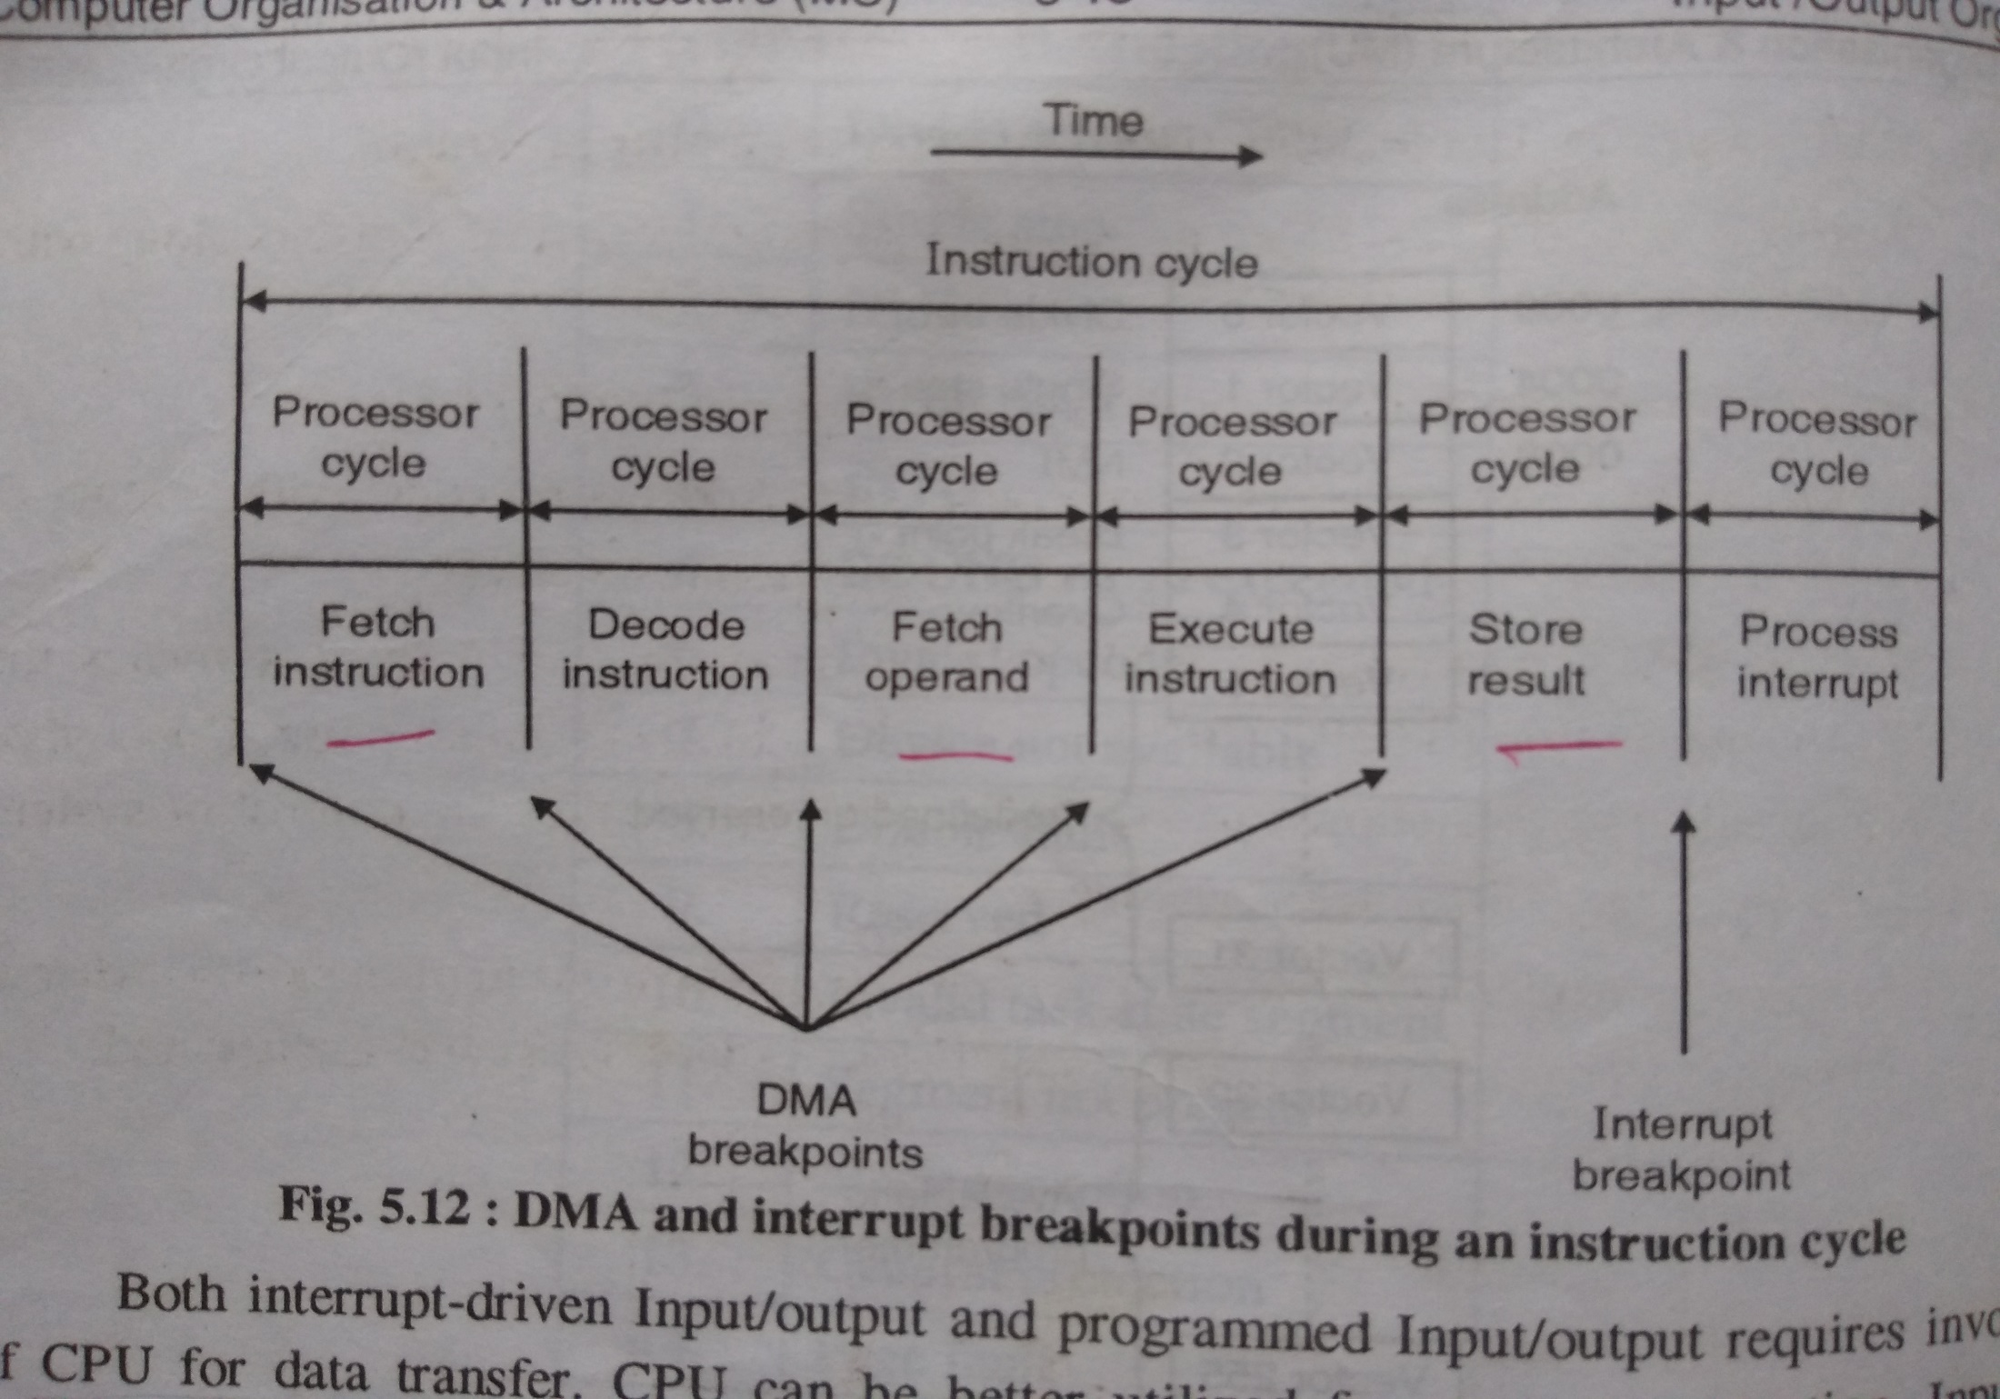
DMA Operation

Slide 42
DMA Operation
DMA data transfer modes:
3.Transparent DMA
DMA is allowed to steal only those cycles when CPU is not using system bus
e.g. decode instruction and execute instruction

Slide 43
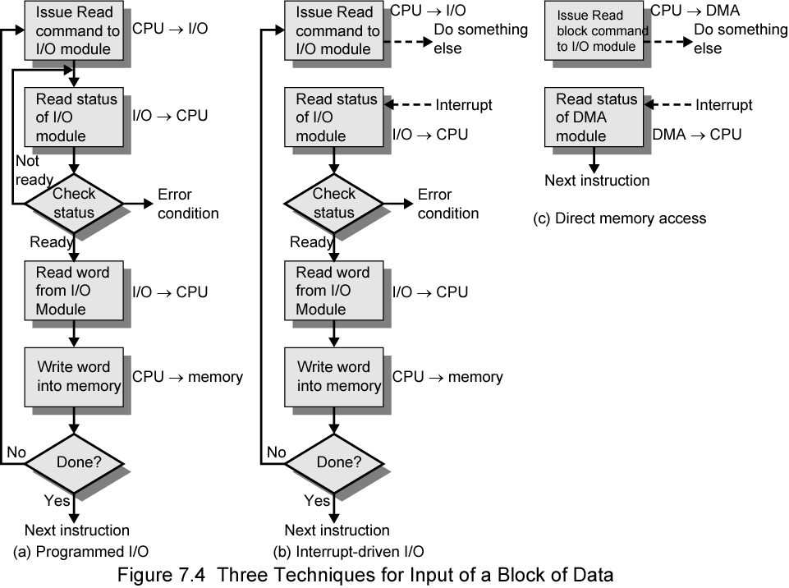
Three Techniques for
Input of a Block of Data

